Slide 1
CSE 460: VLSI Design
Tanvir Ahmed
Lecturer, dept. of cse, brac u
Email: Tanvir.ahmed@bracu.ac.bd

Slide 2
Introduction to Verilog
In the early days of integrated circuits, engineers had to sit down and physically draw transistors and their connections on paper to design them such that it can be fabricated on silicon.
It was tiresome and highly time consuming which is why engineers were looking for other approaches such as simulating the connections beforehand.
Verilog was developed to simplify the process and today verilog is the most popular HDL used and practiced throughout the semiconductor industry.
Verilog is a Hardware Description Language (HDL). A hardware description language is a language used to describe a digital system. By using HDL one can describe any hardware at any level.

Slide 3
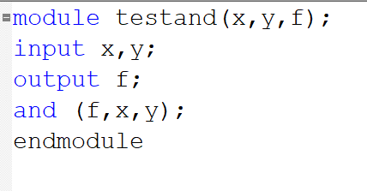
Introduction to Verilog
For the first Verilog program we will simulate a simple 2 input AND gate.
A Verilog code is known as module.
A module has a module_name which is then followed by a list ports.
The ports can be input , output or bidirectional.
Then there will be a brief description of the circuit being simulated.
All Verilog code must end with endmodule.

Slide 4
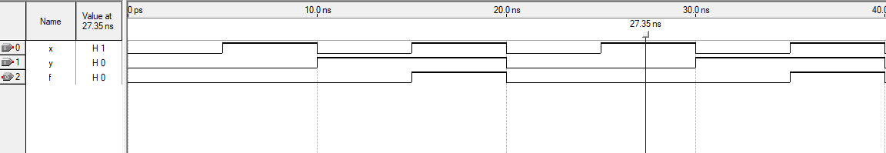
Introduction to Verilog
We can see the output (f) of the previous code in the above graph.
So, This is working as an AND gate.

Slide 5
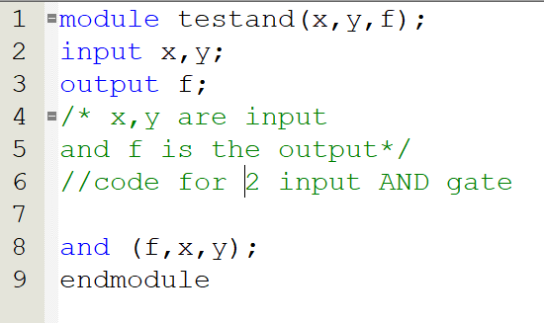
Basic Structure
Documentation in Verilog: Documentation can be included in Verilog code by writing a comment. A short comment begins with a double slash ( // ). A long comment spans multiple lines and is contained inside /* and */.
White Space: white space characters such as SPACE , TAB and Blank spaces are ignored by Verilog compiler.

Slide 6
Basic Structure
Identifier Names:
Identifiers are the names of variables and other elements in Verilog code.
Valid identifier can include any letter and digit as well as “_” and “$” characters.
There are two restrictions too , an identifier must not begin with a digit and it should not be a Verilog keyword.
x1 | Valid identifier
x_y | Valid identifier
1x | Invalid identifier
+y | Invalid identifier
x*y | Invalid identifier
258 | Invalid identifier

Slide 7
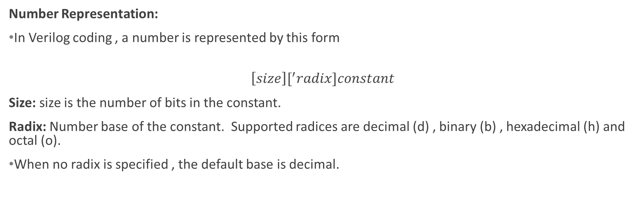
Basic Structure
Number Representation:
In Verilog coding , a number is represented by this form
$$\left[size\right][^{′}radix]constant$$
Size: size is the number of bits in the constant.
Radix: Number base of the constant. Supported radices are decimal (d) , binary (b) , hexadecimal (h) and octal (o).
When no radix is specified , the default base is decimal.

Slide 8
Basic Structure
Number Representation:
0 | The number 0
10 | The decimal number 10
‘b10 | The binary number 10 =(2)₁₀
‘h10 | The hex number 10 = (16)₁₀
4’b100 | The binary number 0100 = (4)₁₀
4’bx | The unknown 4-bit values xxxx
8’b1000_0011 | Valid, “_” can be inserted for readability
8’hfx | Equivalent to 8’b1111_xxxx

Slide 9

Basic Structure
Net :
A net represents a node in a circuit. There are different types of Nets but the net we will be using mainly is called “wire”
Wire type is employed to connect an output of one logic element in a circuit to an input of another logic element.
Wire declaration:
$$wire x;$$
$$wire Cin,Addsub;$$
These are the examples of scalar wire declarations.

Slide 10
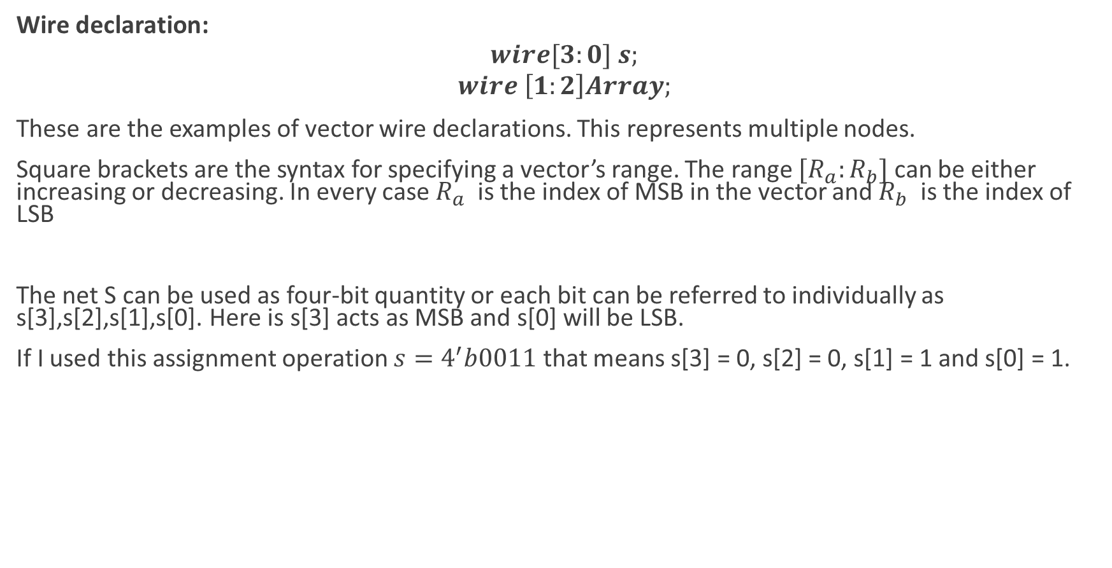
Basic Structure
Wire declaration:
$$wire[3:0] s;$$
$$wire \left[1:2\right]Array;$$
These are the examples of vector wire declarations. This represents multiple nodes.
Square brackets are the syntax for specifying a vector’s range. The range $[R_{a}:R_{b}]$ can be either increasing or decreasing. In every case $R_{a}$ is the index of MSB in the vector and $R_{b}$ is the index of LSB
The net S can be used as four-bit quantity or each bit can be referred to individually as s[3],s[2],s[1],s[0]. Here is s[3] acts as MSB and s[0] will be LSB.
If I used this assignment operation $s=4^{′}b0011$ that means s[3] = 0, s[2] = 0, s[1] = 1 and s[0] = 1.

Slide 11
Basic Structure
Variables
Nets do not allow a circuit to be described in terms of its behavior.
We use variables in Verilog.
A variable can be assigned one value in one Verilog statement.
It retains this value until it is overwritten in another assignment operation.
There are two types of variables
integer
reg

Slide 12
Basic Structure
integer:
integer is declared by this statement in Verilog code : integer k
integer variables describe the behavior of the circuit.
They are essentially loop controlling variables.
reg:
reg is declared by this statement in Verilog code : reg k.
reg is used to model either combinational or sequential parts of the circuit.

Slide 13
Types of Representation
Verilog allows the designer to represent the circuit in two fundamentally different ways.
Structural Representation: Verilog can be used to represent the simple circuit elements such as logic gates. A larger circuit is defined by writing code that connects such elements together. This is referred as structural representation of logic circuits.
Behavioral Representation: Verilog can be used to describe a circuit by using logic expressions and programming constructs that define the behavior of the circuit. This is called the behavioral representation.
Structural representation is easier but it is tedious for large circuits and not efficient. So we will mostly learn behavioral representation of logic circuits.

Slide 14
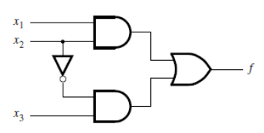
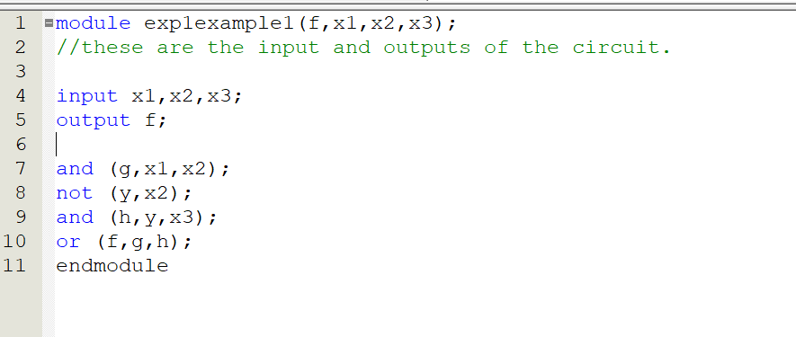
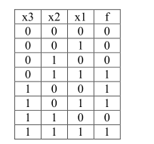
Structural Representation

Slide 15
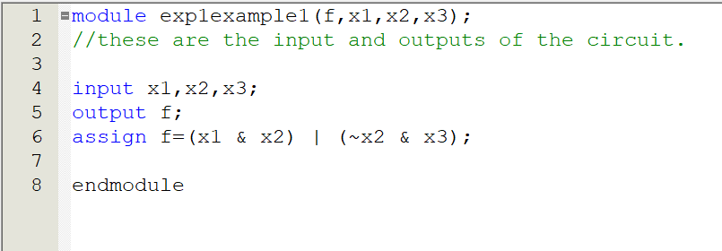
Behavioral Representation

Slide 16
Operators
Verilog has large number of operators.
Bitwise operators:
Operator | Operation
~A | This will produce 1’s complement of A
-A | This will produce 2’s complement of A
A & B | Bitwise AND
A | B | Bitwise OR
A^B | Bitwise XOR
A^~B / A~^B | Bitwise XNOR

Slide 17
Operators
Logical operators:
These operators work on single or multi bit operands but generate 1 bit result i.e true or false
Operator | Operation
!A | NOT A(!A) produces “1(True)” only if all bits of A are 0 else !A gives “0(False)”
A&&B | The result of A&&B is “1(True) if both A and B are nonzero
A|| B | A||B gives “1(True)” unless both A and B are zero.

Slide 18
Operators
Arithmetic operators:
These operators are used for arithmetic operation.
Operator | Operation
A+B | Addition of two single or multibit numbers
A-B | Subtraction of two single or multibit numbers
A*B | Multiplication of two single or multibit numbers
A/B | Division of two single or multibit numbers
A%B | This returns the remainder of the integer division A/B

Slide 19

Operators
Conditional operator:
$A ?B :C$
The result of $A ?B :C$ is equal to B if operand A evaluates to 1(True) otherwise the result is C

Slide 20
Concurrent Statements
In any HDL, concurrent statement means the code may include a number of statements and each represent a part of the circuit.
What concurrent means:
Concurrent is used because the statements are considered in parallel and the ordering of statements in the code doesn’t matter.

Slide 21
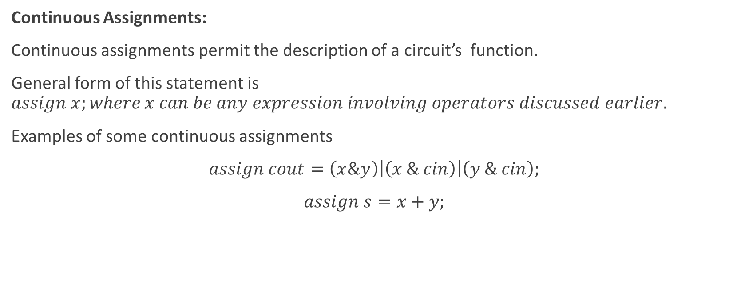
Concurrent Statements
Continuous Assignments:
Continuous assignments permit the description of a circuit’s function.
General form of this statement is $assign x;where x can be any expression involving operators discussed earlier.$
Examples of some continuous assignments
$assign cout=\left(x\&y\right)\left|\left(x \& cin\right)\right|\left(y \& cin\right);$
$assign s=x+y;$

Slide 22
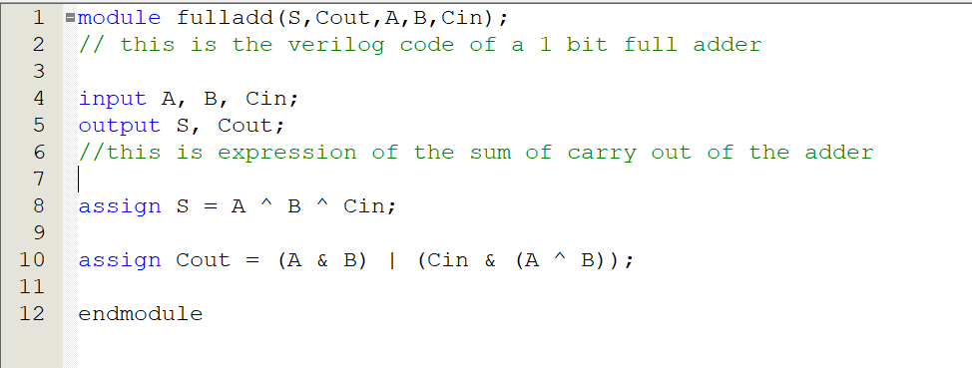
Concurrent Statements
Continuous Assignments:

Slide 23
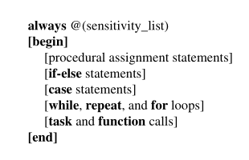
Procedural Statements
In addition to the concurrent statements Verilog also provides procedural statements. As discussed , concurrent statements are executed in parallel, procedural statements are evaluated in the order they appear in the code. Verilog syntax requires that procedural statements to be contained inside an always block
Always Block:
An always block is a construct that contains one or more procedural statements.
When multiple statements are included in an always block . The begin and end keywords must be used.
Output variables within the always block must be variable of reg type.

Slide 24
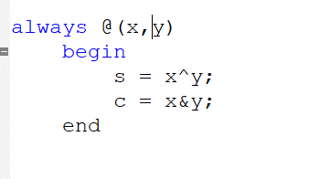
Procedural Statements
Always Block:
Sensitivity_list is the list of variables that directly affect the output results generated by the always block.
The output variable s and c depends on x and y. So these two signals are included in the sensitivity list.
We can separate the elements in the sensitivity list by “or” too.
If the value of a signal in the sensitivity list changes, then the statements inside the always block are evaluated in the order written.

Slide 25
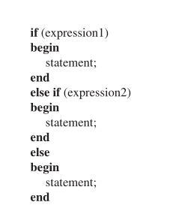
Procedural Statements
The If-else statement:
IF expression1 Is true then the first statement is evaluated.
If not , then the compiler will consider other expressions.
The else if and else clauses are optional.
When multiple statements are involved, they have to be included inside a begin-end block

Slide 26
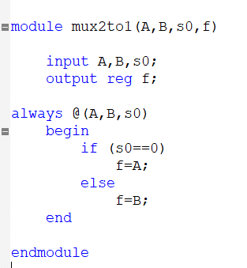
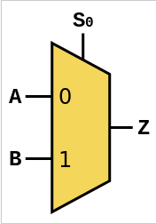
Procedural Statements
The If-else statement:

Slide 27
Subcircuit
A Verilog module can be included as a subcircuit in another module.
Both module must be defined in the same file or else Verilog compiler must be told where each module is located.
The general form of module instantiation expression is module_name instance_name ( port_name[expressions])
module_name is the name of the module of the child circuit that is to be included in the parent circuit.
instance_name can be any legal Verilog identifiers.
port_name basically is the list of ports that specify the connections that will be passed to the subcircuit.

Slide 28
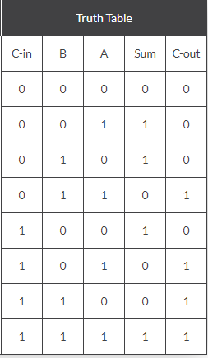
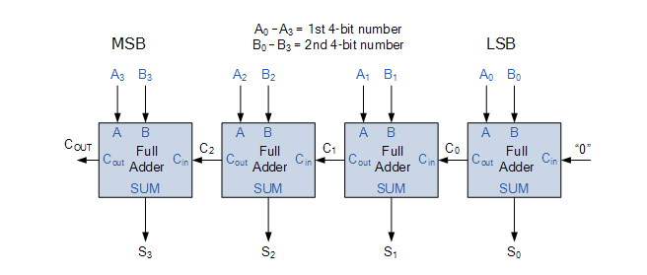
Subcircuit
4 bit ripple carry adder:

Slide 29
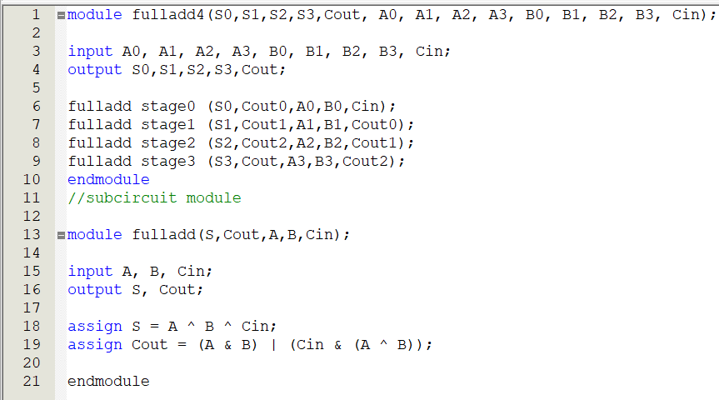
Subcircuit
4 bit ripple carry adder:

Slide 30
Text & References
# | Title | Author(s) | Edition
1. | CMOS VLSI Design | N.H.E. Weste, D. Harris & A. Banerjee | 4th ed.
2. | Fundamentals of Digital Logic with Verilog Design | Stephen Brown & Zvonko Vranesic | 2nd/3rd ed.

